Slide 1

Why I use Julia
And why you might not want to

Slide 2

Pre-Workshop Checklist
1
Julia
Install Julia via JuliaUp
2
Data
Download the data

3
Workspace
Have a workspace ready for Julia coding
💻

Slide 3


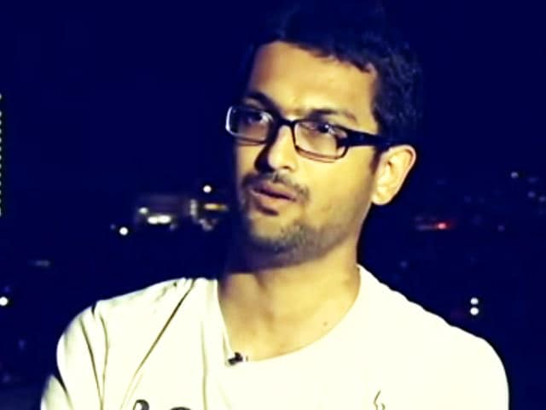

Julia in Brief
2009 | 2012 | 2014 | 2018
Work begins on Julia | Julia officially announced | First JuliaCon | Julia 1.0 released
Jeff Bezanson
We want a language that's open source, with a liberal license. We want the speed of C with the dynamism of Ruby. We want a language that's homoiconic, with true macros like Lisp, but with obvious, familiar mathematical notation like Matlab. We want something as usable for general programming as Python, as easy for statistics as R, as natural for string processing as Perl, as powerful for linear algebra as Matlab, as good at gluing programs together as the shell. Something that is dirt simple to learn, yet keeps the most serious hackers happy. We want it interactive and we want it compiled.
Stefan Karpinski
Viral Shah
Alan Edelman

Slide 4
Why Julia?
Multiple Dispatch
Dynamic Types
Overload functions
Most specific match runs
Types are optional
More info = Faster Code
Metaprogramming
JIT Compiled
Everything in Julia has a type
Code which writes code
Compile code once during runtime
Extendable
Opinionated
Robust Package Ecosystems:
Visualisation, Statistics, Machine Learning, Quantum Computing, HPC, and Astronomy!
Built in:
Package Management, Profiling, Debugging, Logging
Interactable
Interface with C, Fortran, C++, Python, R, Java, Mathematica, Matlab, etc...

Slide 5
Basics: Interacting with Julia
REPL
Interactive command-line read-eval-print loop
] - Package Mode ? - Help Mode ; - Shell Mode Colours Tab Completion Unicode / LaTeX Input
julia ≅ ipython
Notebook
Reactive and Reproducible
Automatic Cell Re-evaluation PlutoUI – Sliders, Buttons, etc... Built-in Package Manager No mutable workspace, no hidden state
Pluto ≅ Jupyter
Scripts
julia script.jl include(“script.jl”)
Feature-Rich VSCode Integration Emacs, Vim, Atom, Zed, Notepad++, Sublime, Intellij, and more!
script.jl ≅ script.py

Slide 6
Basics: Reading, analysing, and writing
JuliaWorkshop/Code/1. Basics/Scripts

Julia
Python
julia script.jl
output_jl.txt
python script.py
output_py.txt

Slide 7
Basics: Environments, Workflow, and Plotting
JuliaWorkshop/Code/1. Basics/Environments/AnalyseLightcurve.{jl,py}

Julia
Python
julia script.jl
output_jl.txt
python script.py
output_py.txt

Slide 8
Basics: Environments and Plotting

] generate AnalyseLightcurve.jl
Create Environment
python -m venv .venv
] activate .
Activate Environment
source .venv/bin/activate
using AnalyseLightcurve
Import Project
import AnalyseLightcurve
AnalyseLightcurve.main()
Run Project
AnalyseLightcurve.main()

Slide 9
Basics: Iterative Workflow

%load_ext autoreload
%autoreload 2
using Revise
Activate AutoReload
edit(AnalyseLightcurve)
Edit code
%edit AnalyseLightcurve.py
;imv Supernova\ Lightcurve.svg
View results
!imv Supernova\ Lightcurve.svg

